Slide 1
Circuit Theory & Analysis
Three Phase Unbalanced Star-Connected Load

Slide 2
Three Phase Circuits
Three Phase Unbalanced
Star-Connected Load
Circuit Theory & Analysis

Slide 3
Objectives
  Understand the characteristics of an
  unbalanced star connected load.
  Derive the relationship for line voltage,
  phase voltage, line current, phase
  current, neutral current, power factor
  and real power.
Circuit Theory & Analysis
Notes:
Student should be able to:
Draw and explain the characteristics of a unbalanced star−connected load.
Draw Phasor diagrams for unbalanced star connected load
Solve problems on unbalanced star load.
Describe the need and importance of three phase four wire star connected system.

Slide 4
Unbalanced Star Load
Definition: Load is said to be unbalanced if the impedance connected to each phase are not equal in
  Magnitude
  Direction
  Both magnitude and direction
Circuit Theory & Analysis

Slide 5
Unbalanced Star Load
Unequal magnitude but same direction
Ex:(1) Z_{A} = 5∠45º ; Z_{B} = 6∠45º ; Z_{C} = 7∠45º
(2) Z_{A} = 4 + j4 ; Z_{B} = 5 + j5 ; Z_{C} = 3 + j3
Unequal direction but same magnitude
Ex:(1) Z_{A} = 5∠55º ; Z_{B} = 5∠75º ; Z_{C} = 5∠85º
(2) Z_{A} = 3 + j4; Z_{B} = 4 + j3 ; Z_{C} = 3 − j4
Unequal direction and magnitude
Ex:(1) Z_{A}= 5∠55º ; Z_{B} = 6∠65º ; Z_{C} = 7∠15º
(2) Z_{A} = 4 + j7 ; Z_{B} = 5 + j3 ; Z_{C} = 1− j10
Circuit Theory & Analysis

Slide 6
3-phase 4-wire Unbalanced star-connected loads
A
400 V, 3φ balanced loads (e.g. motor, oven, etc)
B
N
C
Transformer
secondary
230 V
1φ
230 V
1φ
230 V
1φ
Supply is balanced but the load is not. The above example is a 400/230 V system commonly used in residential and commercial buildings.
Circuit Theory & Analysis
Notes:
The three-phase four-wire system is used extensively in industrial and commercial occupancies where both three-phase power and one-phase power are required. Figure above shows the 400/230 V, three-phase, four-wire system. This system provides the dual advantages of furnishing 230 V one-phase loads (for lighting, single phase motors and small appliances) and balanced 400 V three-phase loads (for large electric motors and ovens).

Slide 7
3-phase 4-wire Unbalanced star-connected loads
A
B
N
C
Transformer
secondary
230 V
1φ
230 V
1φ
230 V
1φ
Star Point
These 3 single-phase loads form an unbalanced 3-phase star connected load
Circuit Theory & Analysis
Notes:
In practice, an attempt is made to balance the 230 V one-phase loads so that there are limited (but equal) numbers of branch circuits on each phase. But depending on the circuits energized, there is always the possibility of some imbalance.

Slide 8
3-φ balanced supply connected to
3-φ 4-wire unbalanced star load
A
Connected to star-connected
balanced
supply
I_{A}
V_{AN}
⎮Z_{A}⎮∠φ_{A}
I_{N}
N'
N
⎮Z_{C}⎮∠φ_{C}
⎮Ζ_{B}⎮∠φ_{B}
I_{C}
C
V_{BN}
I_{B}
V_{CN}
B
The presence of the neutral wire ensures:-
* the phase voltages remain balanced
* the line currents will not be too unbalanced
Circuit Theory & Analysis
Notes:
The phase voltages of a three-phase four-wire system remain undisturbed regardless of load imbalance, whereas the phase voltages of a three-phase three-wire unbalanced load will increase or decrease alarmingly and possibly, dangerously. This will cause damage to the electrical appliances.
The line currents of a three-phase four-wire system tend to remain fairly balanced despite the severely unbalanced load.

Slide 9
3-φ balanced supply connected to
3-φ 4-wire unbalanced star load
Each phase
can be dealt
with just
like single
phase
A
I_{A}
V_{AN}
⎮Z_{A}⎮∠φ_{A}
I_{N}
N'
N
⎮Z_{C}⎮∠φ_{C}
⎮Ζ_{B}⎮∠φ_{B}
I_{C}
C
V_{BN}
I_{B}
V_{CN}
B
Circuit Theory & Analysis

Slide 10
3-φ balanced supply connected to
3-φ 4-wire unbalanced star load
Each phase
can be dealt
with just
like single
phase
A
I_{A}
V_{AN}
⎮Z_{A}⎮∠φ_{A}
I_{N}
N'
N
I_{A} = V_{AN} / ⎮Z_{A}⎮∠φ_{A}
Circuit Theory & Analysis

Slide 11
3-φ balanced supply connected to
3-φ 4-wire unbalanced star load
Each phase
can be dealt
with just
like single
phase
I_{N}
N'
N
⎮Ζ_{B}⎮∠φ_{B}
V_{BN}
I_{B}
B
I_{B} = V_{BN} / ⎮Z_{B}⎮∠φ_{B}
Circuit Theory & Analysis

Slide 12
3-φ balanced supply connected to
3-φ 4-wire unbalanced star load
Each phase
can be dealt
with just
like single
phase
I_{N}
N'
N
⎮Z_{C}⎮∠φ_{C}
I_{C}
C
V_{CN}
I_{C} = V_{CN} / ⎮Z_{C}⎮∠φ_{C}
Circuit Theory & Analysis

Slide 13
3-φ balanced supply connected to
3-φ 4-wire unbalanced star load
A
Each phase
can be dealt
with just
like single
phase
I_{A}
V_{AN}
⎮Z_{A}⎮∠φ_{A}
I_{N}
N'
N
⎮Z_{C}⎮∠φ_{C}
⎮Ζ_{B}⎮∠φ_{B}
I_{C}
C
V_{BN}
I_{B}
V_{CN}
B
I_{A} = V_{AN} / ⎮Z_{A}⎮∠φ_{A}, I_{B} = V_{BN} / ⎮Z_{B}⎮∠φ_{B} and I_{C} = V_{CN} / ⎮Z_{C}⎮∠φ_{C}
If V_{AN} = 25 ∠0°, then
V_{BN} = 25 ∠-120° and
V_{CN} = 25 ∠-240° or = 25 ∠120° volts
Circuit Theory & Analysis
Notes:
Supply voltage is balanced but not the load.
The magnitude of the line currents need not to be equal nor 120 degree apart.

Slide 14
3-φ balanced supply connected to
3-φ 4-wire unbalanced star load
A
Each phase
can be dealt
with just
like single
phase
I_{A}
V_{AN}
⎮Z_{A}⎮∠φ_{A}
I_{N}
N'
N
⎮Z_{C}⎮∠φ_{C}
⎮Ζ_{B}⎮∠φ_{B}
I_{C}
C
V_{BN}
I_{B}
V_{CN}
B
From Kirchhoff's current law (for I_{N} towards the load or away from the supply)
I_{A} + I_{B} + I_{C} + I_{N} = 0 (vector equation)
I_{N} = - (I_{A} + I_{B} + I_{C}) (vector equation)
Circuit Theory & Analysis
Notes:
The neutral current will not be zero unlike balanced load.

Slide 15
3-φ balanced supply connected to
3-φ 4-wire unbalanced star load
A
Each phase
can be dealt
with just
like single
phase
I_{A}
V_{AN}
⎮Z_{A}⎮∠φ_{A}
I_{N}
N'
N
⎮Z_{C}⎮∠φ_{C}
⎮Ζ_{B}⎮∠φ_{B}
I_{C}
C
V_{BN}
I_{B}
V_{CN}
B
From Kirchhoff's current law (for I_{N} away from the load or towards supply)
I_{N} = I_{A} + I_{B} + I_{C} (vector equation)
Circuit Theory & Analysis
Notes:
The neutral current will not be zero unlike balanced load.

Slide 16
3-φ balanced supply connected to
3-φ 4-wire unbalanced star load
A
Each phase
can be dealt
with just
like single
phase
I_{A}
V_{AN}
⎮Z_{A}⎮∠φ_{A}
I_{N}
N'
N
⎮Z_{C}⎮∠φ_{C}
⎮Ζ_{B}⎮∠φ_{B}
I_{C}
C
V_{BN}
I_{B}
V_{CN}
B
Total power consumption of this unbalanced load is equal to the sum of the power consumption of the three individual phases.
Circuit Theory & Analysis
Notes:
Cannot apply the formula
P = 3 V_{PH} I_{PH} cos φ = square root 3 V_{L} I_{L} cos φ
Why ?

Slide 17
Phasor diagram of an unbalanced star load
Phasor diagram
I_{C}
V_{CN}
Phase sequence
ABC
V_{CA}
φ_{C}
V_{AB}
120⁰
30⁰
I_{N}
V_{AN}
ω
Ref
φ_{A}
I_{B}
φ_{B}
I_{A}
Ι_{Ν} = Neutral current
flowing towards supply
V_{BN}
30⁰
I_{N} = I_{A} + I_{B} + I_{C} (vector equation)
θ^{O}
I_{N}
Ref
V_{BC}
I_{A}
I_{C}
Circuit Theory & Analysis
I_{B}
Notes:
Balanced Supply
Taking V_{RN} as reference
The load phase voltages V_{RN}, V_{YN} and V_{BN} have the same magnitude but differ from each other by 120° in the RYB sequence.
The line voltages V_{RY}, V_{YB} and V_{BR} is square root 3 the phase voltages and leads the respective phase voltages by 30 degrees or between them they are 120° apart.
The current phasors may be different for different loads.
I_{R} lags V_{RN} implies that Z_{R} is an inductive load.
I_{Y} lags V_{YN} implies that Z_{Y} is an inductive load.
I_{B} leads V_{BN} implies that Z_{B} is a capacitive load.

Slide 18
Phasor diagram of an unbalanced star load
Phasor diagram
I_{C}
V_{CN}
Phase sequence
ABC
V_{CA}
φ_{C}
V_{AB}
120⁰
30⁰
V_{AN}
ω
Ref
φ_{A}
I_{B}
I_{N}
I_{A}
φ_{B}
Ι_{Ν} = Neutral current
flowing towards load
V_{BN}
30⁰
I_{N} = -(I_{A} + I_{B} + I_{C}) (vector equation)
Ref
I_{N}
θ^{O}
I_{A}
V_{BC}
I_{C}
I_{B}
Circuit Theory & Analysis

Slide 19
Example 2.8
The branch impedances of a 3-phase Y-connected load are Z_{A} = (5−j10), Z_{B} =(6+j5), and Z_{C} = (3+j15). The load is connected to a 3-phase, 440 V, 50Hz balanced Y-connected supply system. Calculate the line currents, each phase power, reactive power, the overall system power factor and neutral current.Take V_{AN} as reference.
Circuit Theory & Analysis

Slide 20
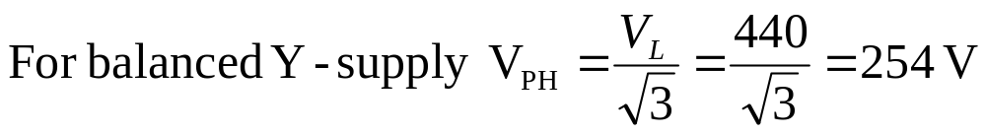


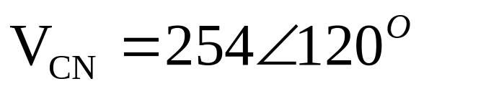
Example 2.8
Solution:
Taking V_{AN} as reference.
Circuit Theory & Analysis

Slide 21
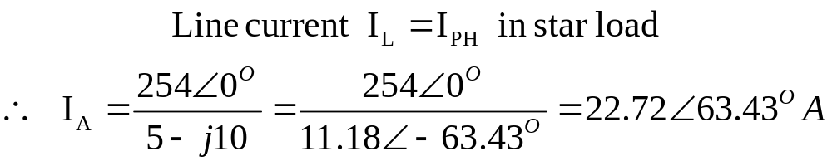
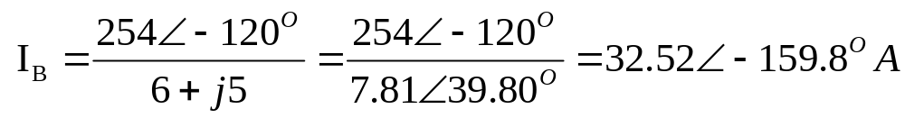
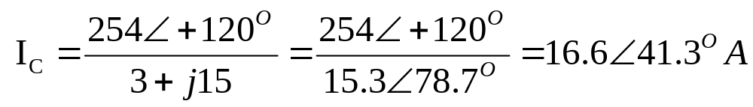
Example 2.8
Solution:
Circuit Theory & Analysis

Slide 22
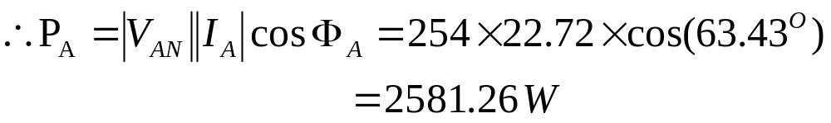
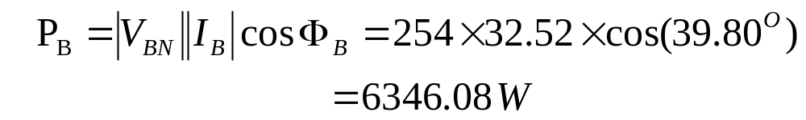
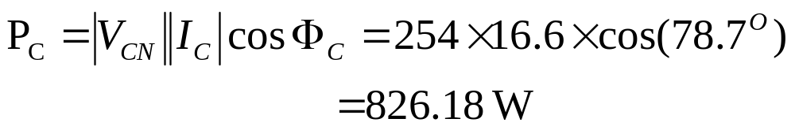
Example 2.8
Solution:
Circuit Theory & Analysis

Slide 23
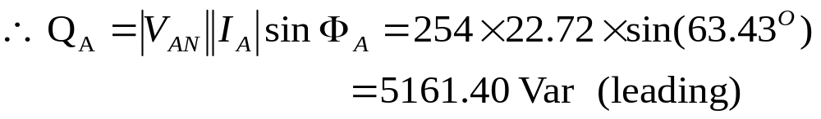
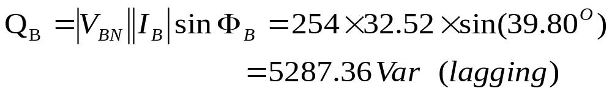
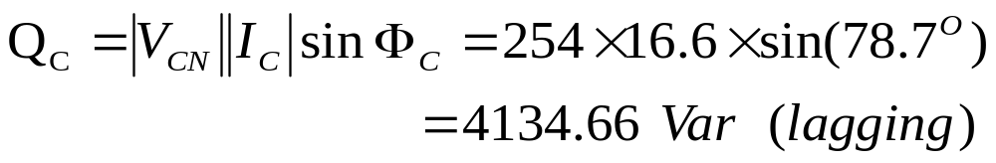
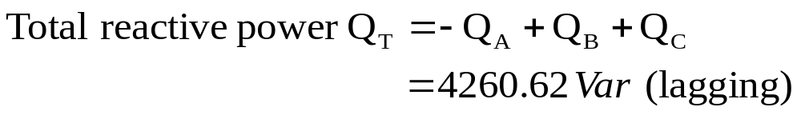
Example 2.8
Solution:
Circuit Theory & Analysis
Notes:
Z_{R}=(5−j10) capacitive load (leading power factor) power triangle points down
Z_{Y}=(6+j5) inductive load (lagging power factor) power triangle points up
Z_{B}=(5+j15) inductive load (lagging power factor) power triangle points up

Slide 24
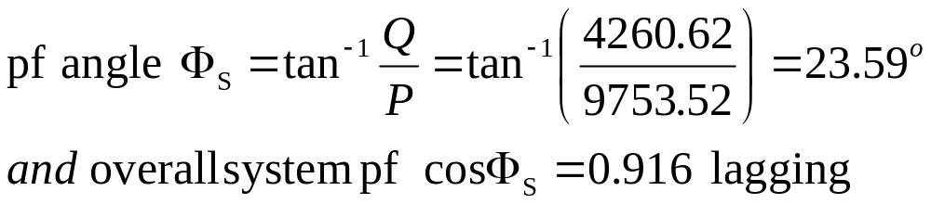
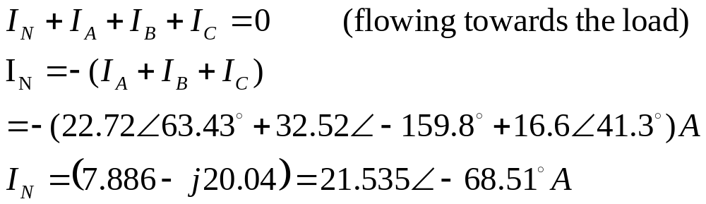
Example 2.8
Solution:
Circuit Theory & Analysis

Slide 25
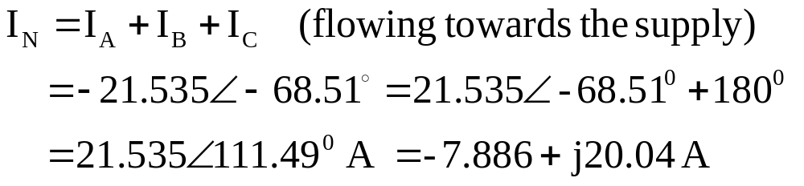
Example 2.8
Solution:
111.49^{O}
Ref
−68.51^{O}
Circuit Theory & Analysis

Slide 26
Three Phase Power Measurement
Lee M L
Office: T12A522
School of EEE
Tel: 6879-0657

